Slide 1







Campus
Expense Manager.
Group 2
08/12/2024
Group Members:
MAI ICH KIEN
BUI THAI DUONG
DOAN DO DAT
NGUYEN MINH ANH

Slide 2

Project Overview
Stakeholders
Investor | Want to build an effective and reliable cost management system. Expect the product to have the potential to expand and increase competitiveness in the market.
Users | Main target audience: Students who need to manage spending and savings. Want a friendly, easy-to-use application that supports tracking and analyzing spending.
Development team | Consists of 4 members in charge of design, development, and testing. Aiming to complete the project on schedule, creating a product that is easy to expand and maintain.

Slide 3
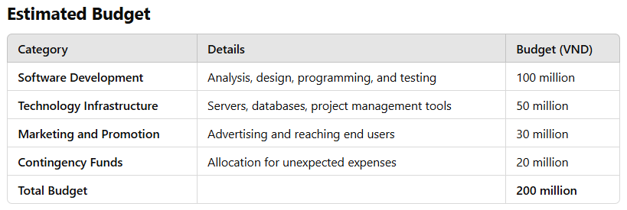
Project Challenges
- Time Management: Meeting deadlines while ensuring all features are fully developed.
- Limited Resources: The development team consists of only 4 members, leading to a high workload.
- User Needs: Understanding and meeting the needs of students, the primary target audience.

Slide 4
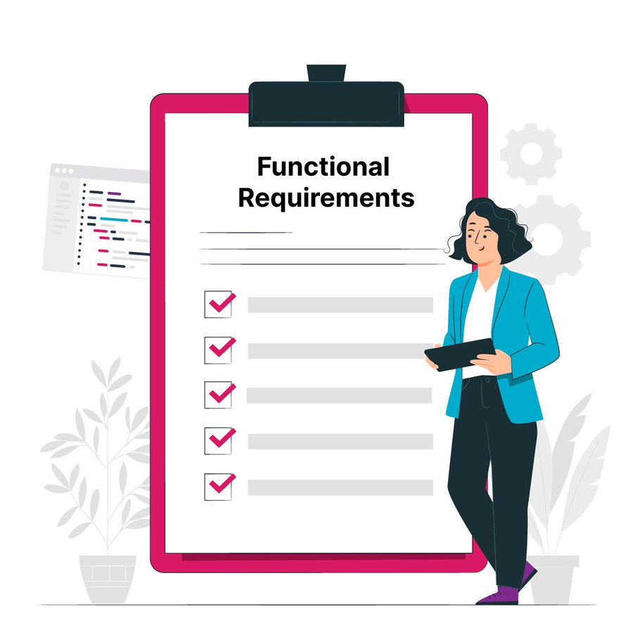

Functional Requirements
- User Registration and Authentication
Users (students) should be able to register, log in, and securely authenticate using email and password, with options to reset forgotten passwords.
- Expense and Budget Management
Users can add, edit, and delete expense entries, with customizable categories (e.g., food, transportation). They can also set and track monthly or weekly budgets, receiving alerts when exceeding limits.
- Reports
The system should generate reports on expenses for different time periods (daily, weekly, monthly)

Slide 5

Non-functional requirements
- Scalability
The application must be scalable to accommodate increasing user numbers and data volumes without major changes.
- Usability and Compatibility
The interface must be intuitive and accessible to all students, available in English and Vietnamese. The interface must be compatible with the latest versions of Android, optimized for different screen sizes.
- Reliability and Security
The system must have 99.5% uptime, with daily backups to prevent data loss. The codebase must be clean and modular for easy updating and bug fixing, ensuring smooth operations with minimal disruption.

Slide 6
Challenge of lack of experience
- Inexperienced Staff
The team consists of members with limited experience, which can lead to slower development, errors, and a learning curve in implementing advanced features and technologies. Additional training or external support may be needed to overcome this challenge.
- Time constraints
Meeting project deadlines while ensuring high-quality work and addressing user needs can be a challenge, especially with a small, inexperienced team.
- User expectations
Accurately understanding and meeting the diverse needs of the target audience (students) can be difficult, especially with limited user research and testing.
- Technical challenges
Integrating multiple platforms (Android) and ensuring seamless data synchronization and security can lead to technical challenges, requiring more time for development and testing.

Slide 7
Unforeseen budget challenges
- Unclear Budget Estimates
The initial budget has not been accurately calculated, which could result in unforeseen expenses or budget overruns. This may require revising the budget or seeking additional funding to cover costs

Slide 8
Unforeseen budget challenges
- Unclear Budget Estimates
The initial budget has not been accurately calculated, which could result in unforeseen expenses or budget overruns. This may require revising the budget or seeking additional funding to cover costs

Slide 9
Platform
The app will be developed for the Android platform, ensuring cross-device accessibility for students to manage their expenses.
Essential Features
- User Authentication
Secure login, registration and password recovery, with optional two-factor authentication for added security.
- Expense and Budget Management
Users can add, edit, categorize and track expenses, set recurring payments and set monthly or weekly budgets with notifications when approaching the limit.
- Expense Reporting and Analysis
Generate detailed reports and visual analysis (pie charts, bar charts) to track spending trends over time.
- Data Backup and Restore
Automatic backup and restore options to prevent data loss.

Slide 10
Potential Risks and Management
- Limited Resources: With a small, inexperienced team, delays and quality issues may arise. Providing additional training, hiring consultants if necessary, and prioritizing critical tasks can help mitigate this risk.
- Budget Overruns: An underestimated budget may cause unexpected expenses. Tracking expenses regularly, maintaining a contingency fund, and revising the budget as necessary will help prevent budget issues.

Slide 11
Potential Risks and Management
- Technical Challenges: Integration of Android and web platforms could lead to technical difficulties. Thorough testing and involving experts for complex tasks can minimize this risk.
- Security Vulnerabilities: Storing sensitive data introduces security risks. Implementing strong encryption, conducting regular security audits, and complying with data protection regulations will help safeguard against these threats.
- User Adoption and Retention: Low student engagement may affect the app’s success. A user-friendly design, targeted marketing, and continuous updates based on user feedback will improve adoption and retention.

Slide 12
Thank you very much!

